Slide 1
THE CITY AS A CATALYST OF THE ECONOMY
Tadashi MATSUMOTO, Ph.D.
Centre for Entrepreneurship, SMEs, Regions and Cities (CFE)
OECD
Euskal Hiria Conference
26 November, 2019, San Sebastian

Slide 2
Introduction

Slide 3
Objective of the presentation
Understand economic performance of different cities and regions
Compared internationally and within a country
Discuss key factors affecting economic performance of cities and regions
Discuss key policy implications
Role of national governments
multi-level governance

Slide 4
OECD approach: Better Policies for Better Lives “Productive Economies, Inclusive Societies”
Economic
Efficiency
Green growth
Inclusive growth, Inclusive productivity
Regions and Cities
Social Equity
Environment
Sustainability
Social/Environment nexus / Just transition

Slide 5















OECD Principles on Urban Policy
Notes:
= regulations, safeguarding public good,m and well being as the outcome
all of terriory approach
cross sectoral, managing trasdeoffs

Slide 6
Regional productivity

Slide 7
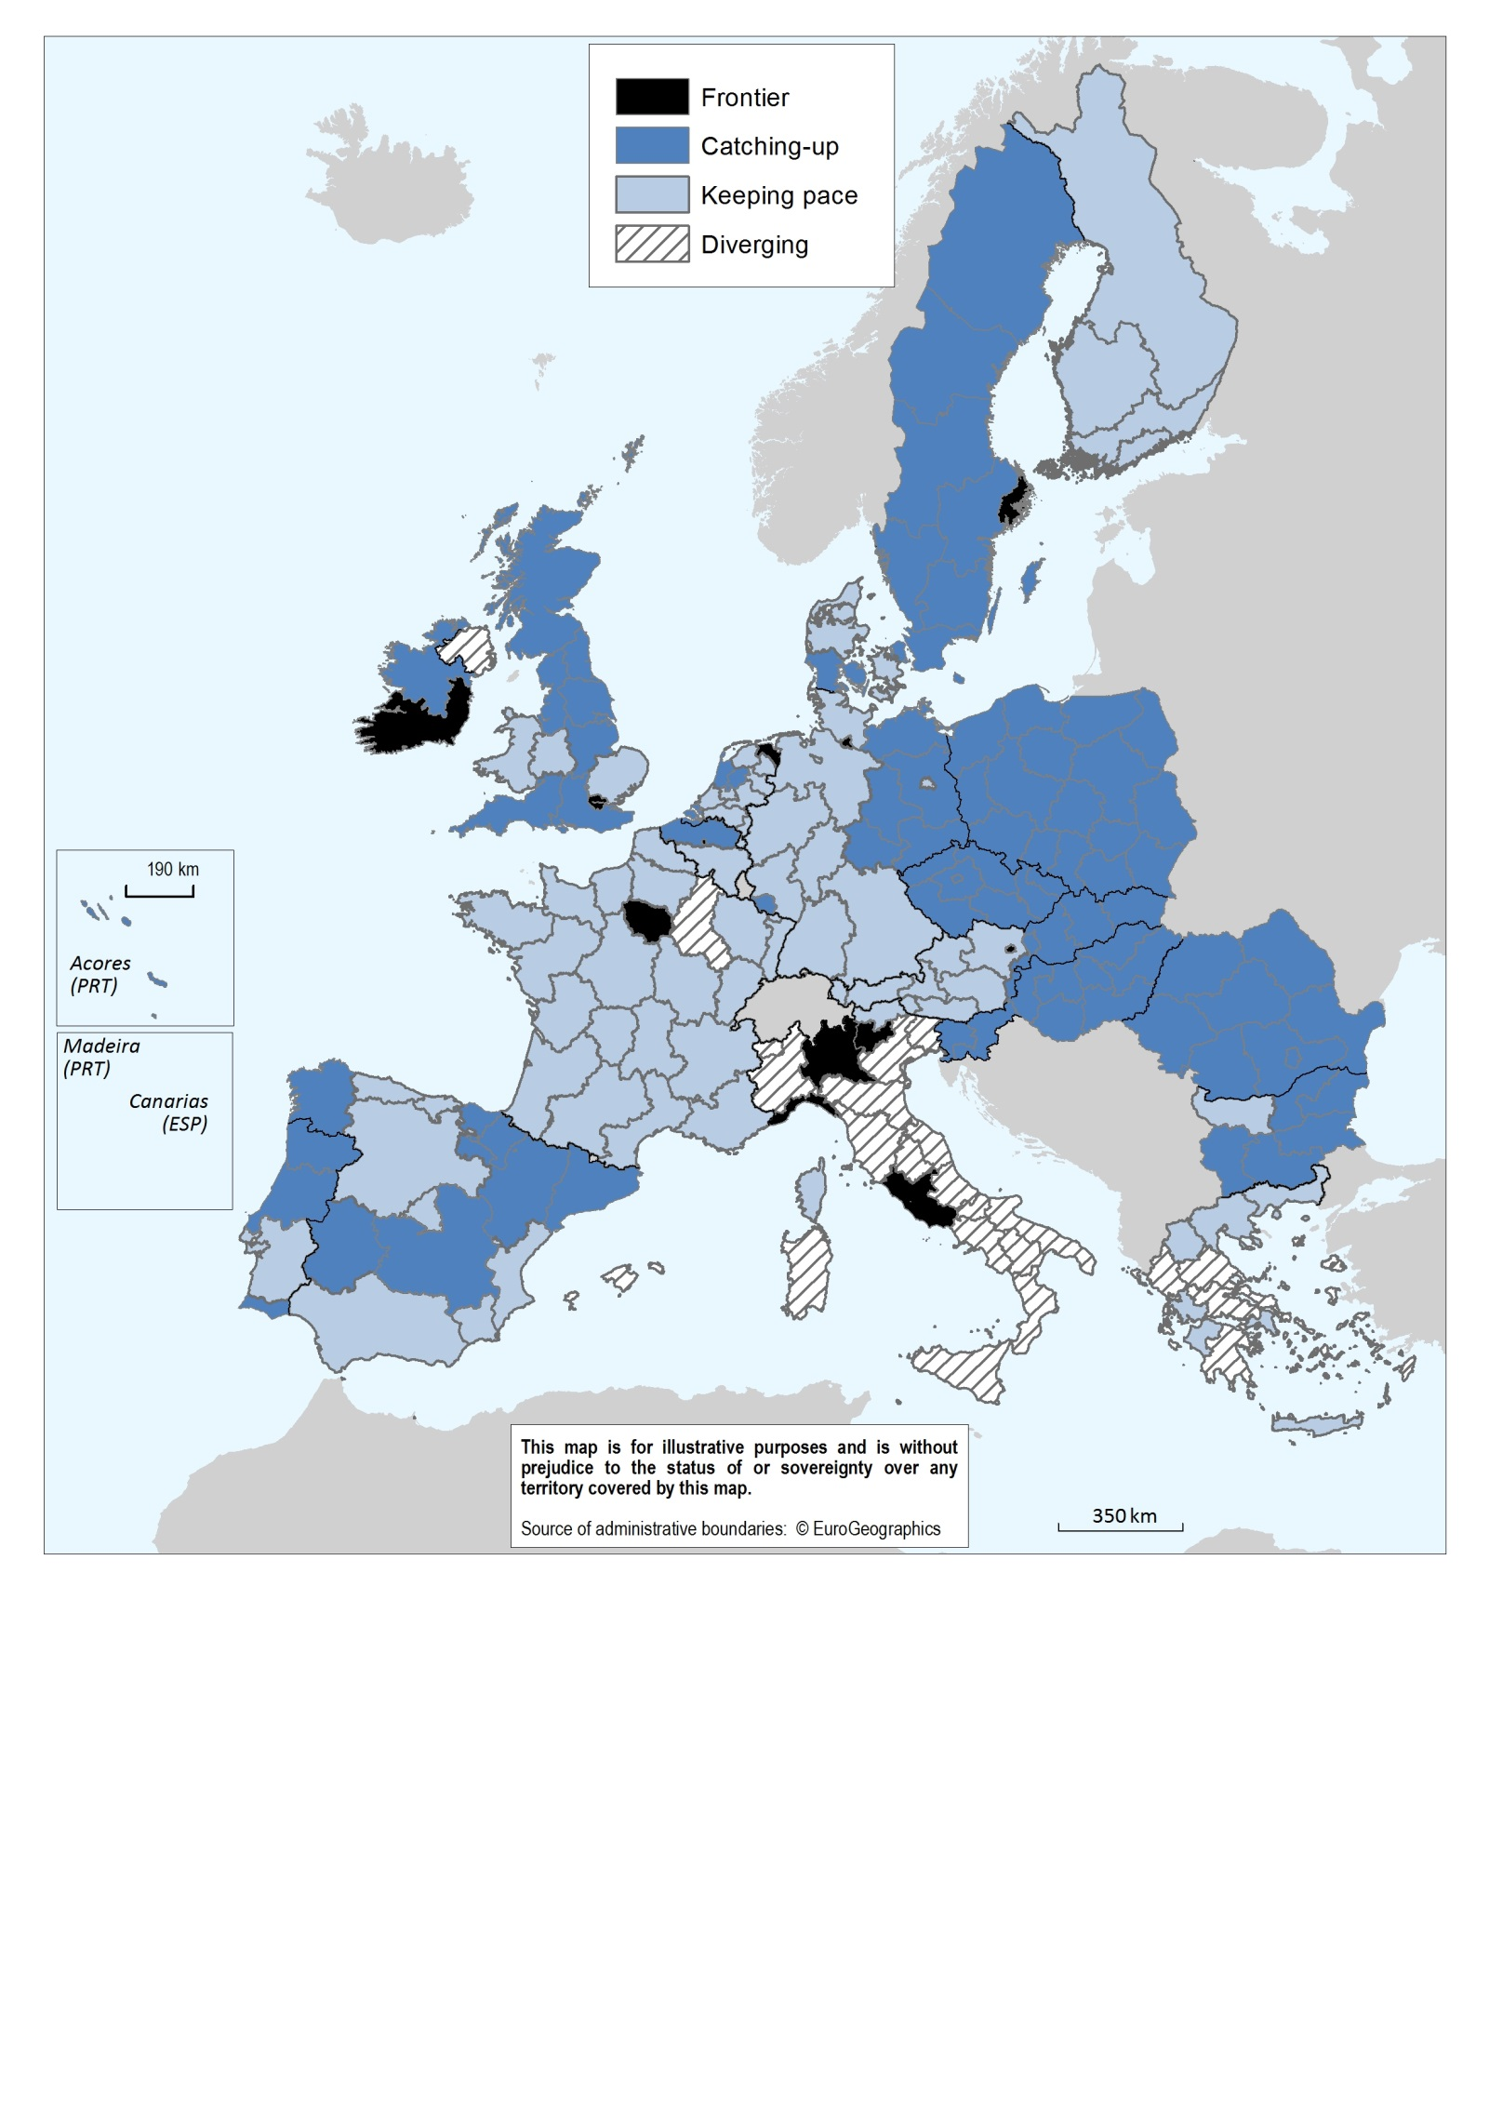
Regional productivity has converged to the EU frontier…
Frontier regions
Most productive regions accounting for 10% of EU total employment
Catching up regions
Productivity growth is 5% higher than in the frontier over 2000-14
Source : OECD (2018) Productivity and Jobs in a Globalised World: (How) Can All Regions Benefit?

Slide 8
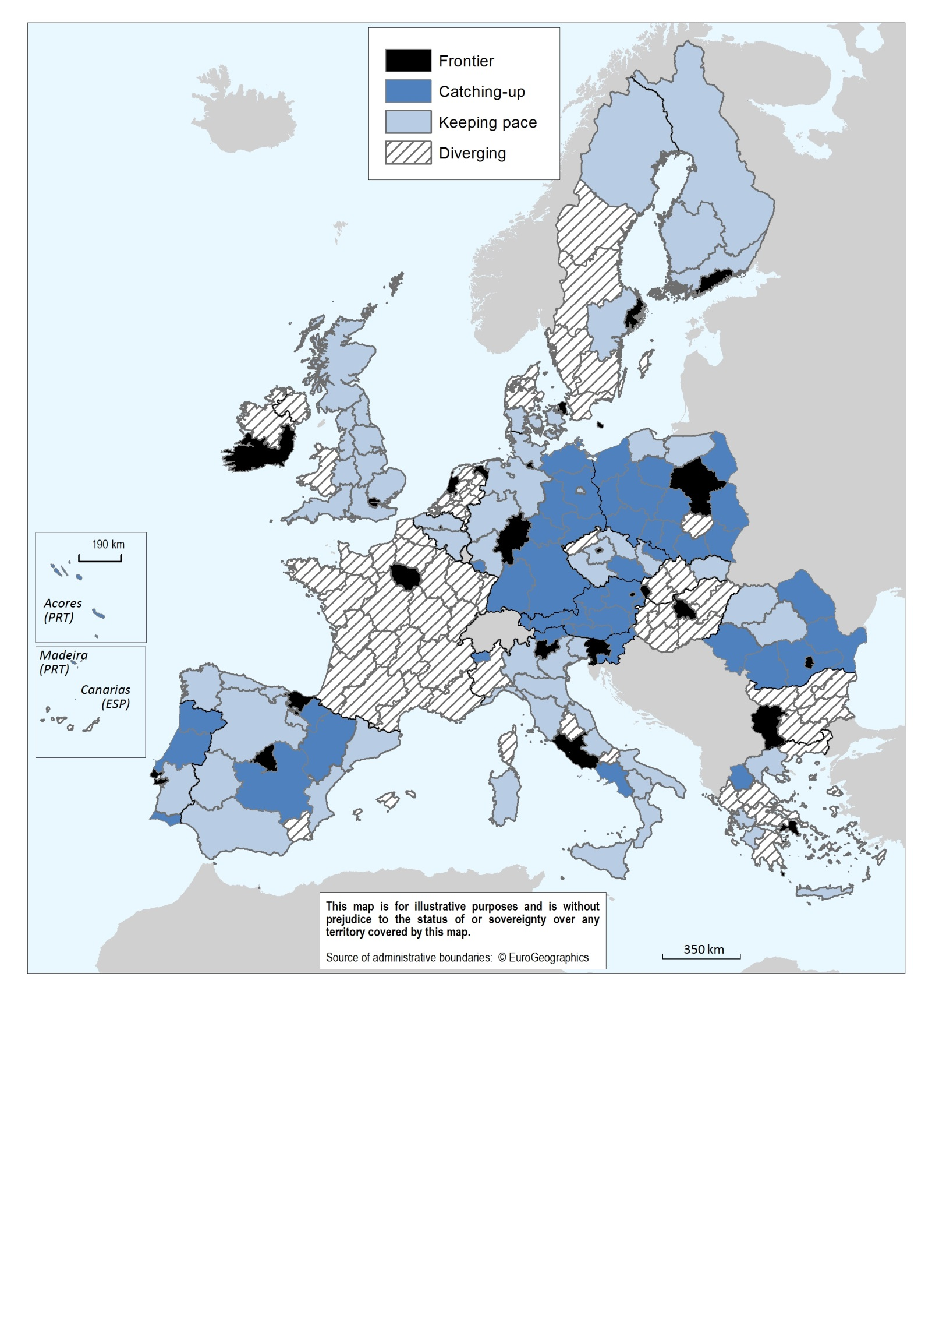
…but in some countries has diverged relative to the national frontiers
Source : OECD (2018) Productivity and Jobs in a Globalised World: (How) Can All Regions Benefit?

Slide 9
Two models of contribution of regions to national productivity
Type-I Distributed:
Aggregate productivity results mainly from the catching-up of the lagging regions:
Austria
Czech Republic
Germany
Italy
Norway
Poland
Portugal
Romania
Spain
Type-II Concentrated: Aggregate productivity growth is concentrated at the frontier region:
Bulgaria
Denmark
France
Finland
Greece
Hungary
Netherlands
Slovak Republic
Sweden
United Kingdom
Source: Bachtler, Oliveira Martins, Wostner and Zuber(2017), “TOWARDS COHESION POLICY 4.0”, Regional Studies Association.

Slide 10
Regional Productivity convergence Spain, TL2 regions, 2000=100

Slide 11
Regional Productivity divergence UK, TL2 regions, 2000=100

Slide 12
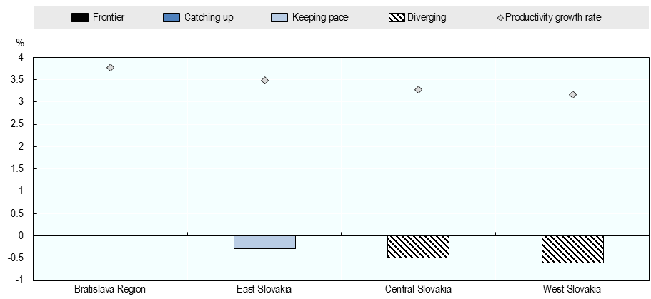
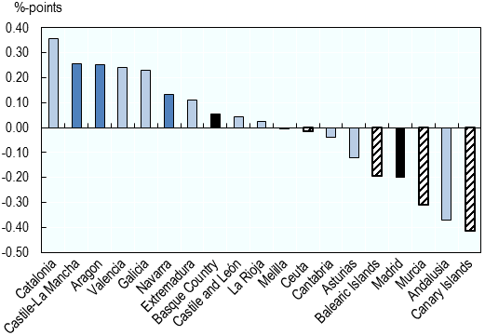
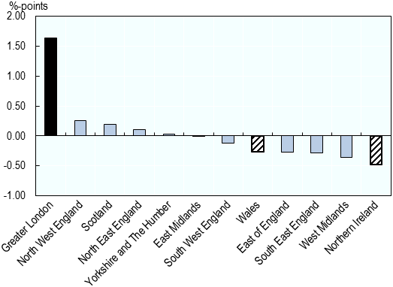
(Pseudo) contributions of regions to national productivity growth, 2000-2014
SPAIN (TYPE I Distributed)
UK (TYPE II Concentrated)
The contribution of a region is defined as the difference between the national annual average labour productivity growth rate and the same rate excluding the indicated region, cf. OECD Regional Outlook (2016).

Slide 13
How to address regional development trade-offs within countries?
There are two polar policy models:
Compensating the lagging regions and promote labour mobility
➔ This do not seem to work over the long-run and may trigger the “geography of discontent” (McCann) or the “revenge of places that don’t matter” (Rodrigues-Pose )
Adopt a place-based (or territorial) approach for regional productivity and development
➔ Quite demanding to adopt tailored development strategies, in particular a strong investment in multi-level governance

Slide 14

The geography of discontent

Slide 15
Cities as laboratories for experimentation
Cities can provide real tests for complex challenges that could eventually be scaled up to national level
Cities are a platform for the innovation economy, as most of the innovations are taking place at the city level.
Digitalisation and urbanisation are driving innovation and entrepreneurship in cities.
ICT and digital technology open up new ways of service delivery, new jobs, and better investments in regional infrastructure (e.g. Korea)
Notes:
Also calls for investment in innovation: cities are laboratories for testing solutions for complex local challenges that could eventually be scaled up to national level: they are the platform for the innovation economy, as most of the innovations are taking place at the city level. In some countries, digitalisation and urbanisation are driving innovation and entrepreneurship in cities. Experience of Korea suggests that ICT and digital technologies open up new ways of service delivery, create new employment, and make better investments in regional infrastructure.

Slide 16

Enhancing innovation capacity in cities
Survey of 89 cities in the world
To understand and assess where, how & why city governments are developing their capacity to innovate
Joint project of OECD & Bloomberg Philanthropies

Slide 17
Case of UK

Slide 18
UK Core Cities perform worse than second-tier cities in other OECD countries
Core Cities:
Birmingham
Bristol
Cardiff
Glasgow
Leeds
Liverpool
Manchester
Newcastle
Nottingham
Sheffield
+ Belfast
Per capita GDP in second-tier cities as % of national average
Notes:
Note: The figure plots the average GDP per capita in second-tier cities relative to the national average. Second-tier cities are defined for this figure as the 10 largest cities outside of the largest city of a country. The figure shows all OECD countries with at least 10 second-tier cities with more than 250 000 inhabitants.

Slide 19
Core Cities suffer from low productivity
Two factors responsible for low productivity:
Disadvantageous workforce and sector composition
Agglomeration economies that are below potential

Slide 20
Need for accessibility-supported economic development
The UK has the highest level of road congestion in Europe
Note: Hours spent in road congestion by the average driver in year 2017. This indicator assumes two 30km trips per day (morning peak and evening peak) and 220 working days. It takes into account all major roads in the Member States for which data is available (about 2 500 000 kilometers). Source: European Commission calculation based on JRC and TomTom statistics.

Slide 21
Deprived neighbourhoods hamper productivity and inclusive growth
Note: City covers only the Local Authority of the corresponding city. Commuting Zone is the unweighted average of all of the other Local Authorities that form the Functional Urban Area. Core Cities correspond to unweighted averages for both groupings. Data for Britain is from 2014, Wales 2016, Scotland and Northern Ireland from 2017
Source: OECD calculations based on statistics provided by the Department for Communities and Local Government, Scottish Government, Welsh Government
Notes:
The Index of Multiple Deprivation 2015 is the official measure of relative deprivation for small areas (or neighbourhoods) in England. The index is composed of multiple factors that capture the deprivation experienced by people in an area. Then, all areas are ranked nationally, according to their index score from the most deprived area to the least deprived area. It is common to describe how relatively deprived a small area is by saying whether it falls among the most deprived 10 percent.

Slide 22
Key recommendations
Develophigh productivity sectors based on local strength (e.g., knowledge-intensive services)
Improve labour market training for low skilled workers and prevent skill mismatches
Increase labour force participation (e.g., improving school-to-work transition, expanding childcare provision)
Sufficient housing development is crucial for inclusive urban growth
Integrate Core Cities with surrounding towns (e.g., regional spatial planning, improve accessibility with public transport)
Place-making matters for productivity (more appealing cities attract investment and high-skilled workers)
Notes:
Notes:
Labour force participation:
Labour force participation in Core Cities 6 percentage points below UK average (but still OK by international comparison)
Childcare costs in the UK are very high. For a couple with 67% of the average wage, they make up 46% of household income, the highest value of all OECD countries.
Invest in retaining graduates/high-skilled workers:
Core Cities have a share of 35% tertiary educated workers compared to a national average of 39%. It is unusual that large cities have a lower share of workers with tertiary education than the national average.
Improve labour market training for low skilled workers:
The UK has a high share of workers with tertiary education by international standards, but workers with low educational levels perform comparatively poorly in basic aptitude tests (PIAAC, basic reading and maths, etc.)
Housing:
House price-to-income ratios in Core Cities moderate for UK standards but high by international comparisons
House price-to-income ratio in Core Cities is 7.4, which is low by UK standards, but still high by international standards (4-5 is considered affordable)

Slide 23
Conclusions

Slide 24
National strategies to foster the role of cities and regions
Benefit from agglomeration economies in large and dense urban areas
Develop high-productivity sectors (e.g. service sectors)
labour market training for low skilled workers
Support innovation capacity of cities
Sufficient housing development
Promote regional productivity catching-up in regions intermediate/rural close to cities
Integrate urban areas with surrounding towns and generate ‘borrowed’ agglomeration economies
Accessibility-supported economic development

Slide 25
Thank you!

